Slide 1
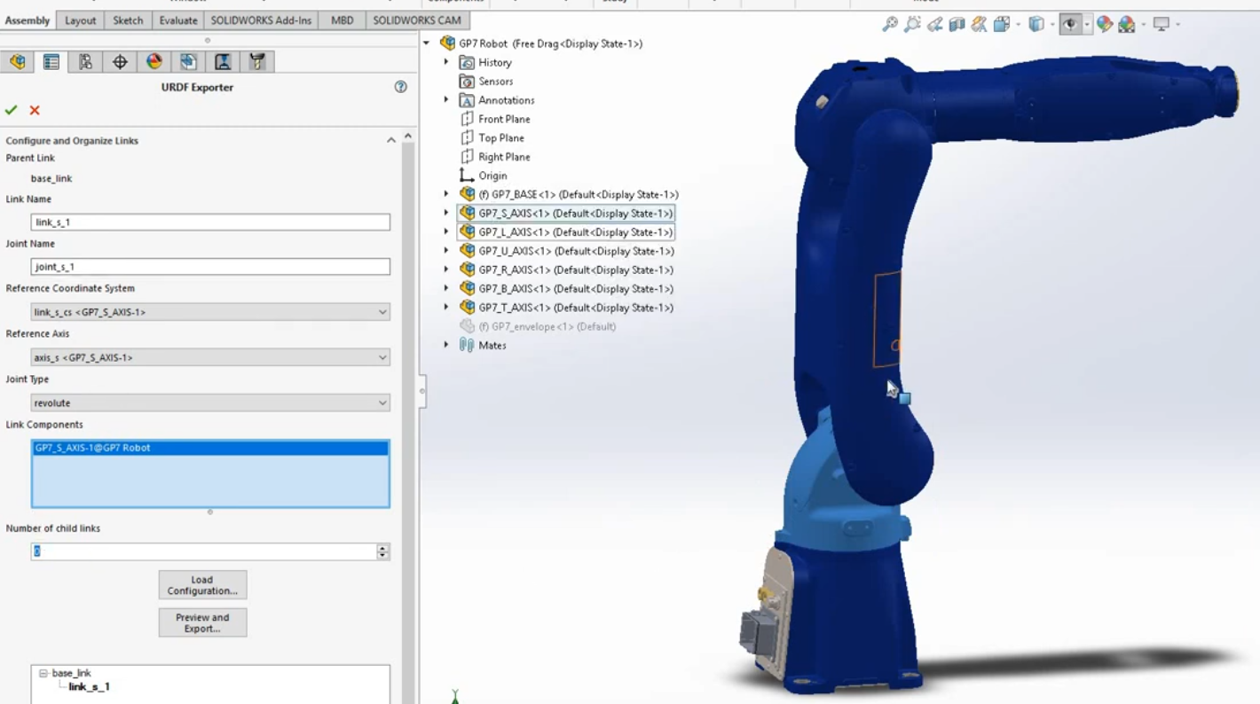
Configure and Organize Links
Instance 1

Slide 2
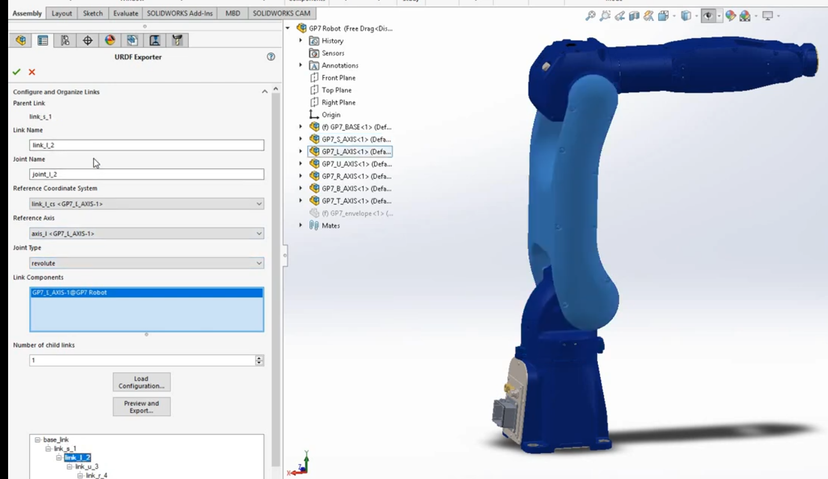
Configure and Organize Links
Instance 2

Slide 3
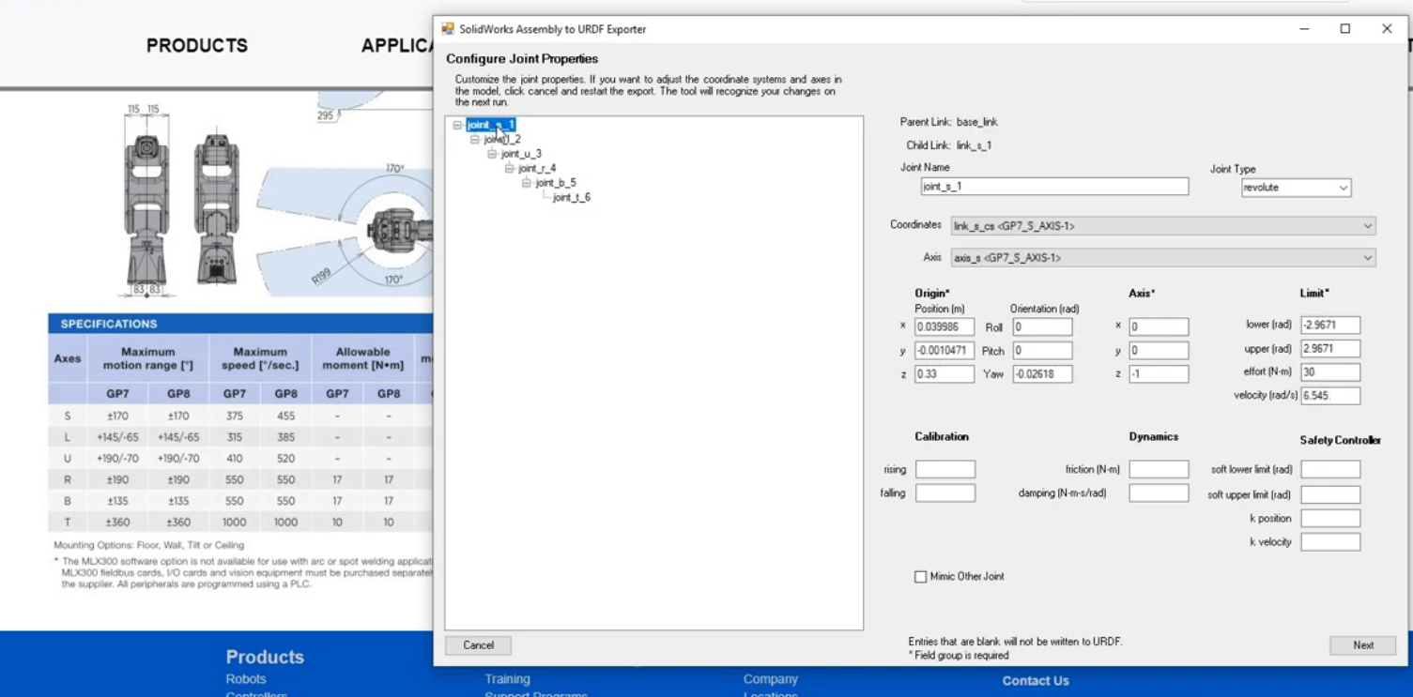
Configure Joint Properties

